Slide 1
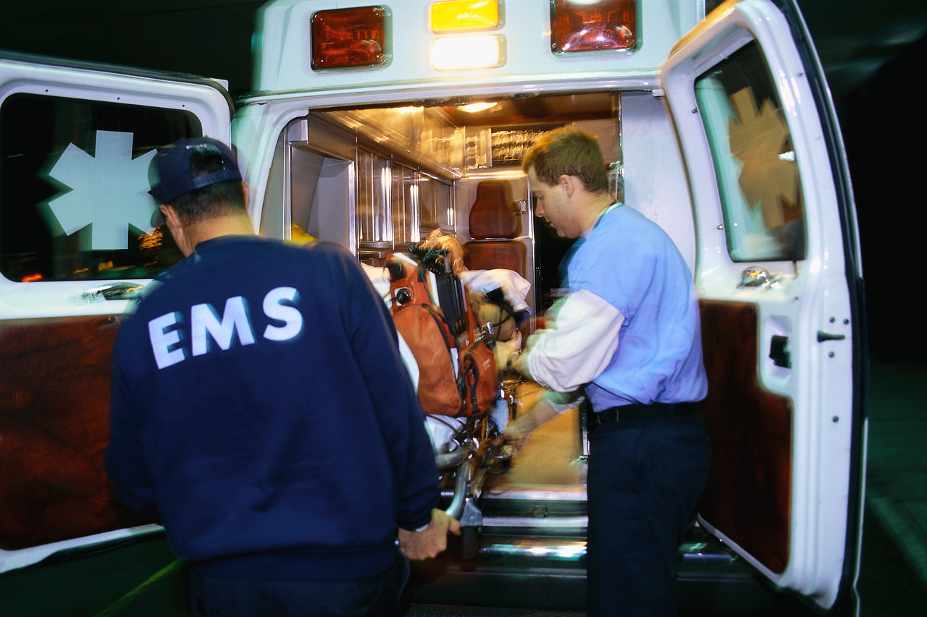
Global burden of injury
伤害的全球负担
Stephen W Hargarten 医学博士，公卫硕士
美国威斯康星医学院分管全球卫生副院长
急诊医学教授、主任
伤害研究中心主任
Hainan Medical University
海南医学院
March 2017

Slide 2
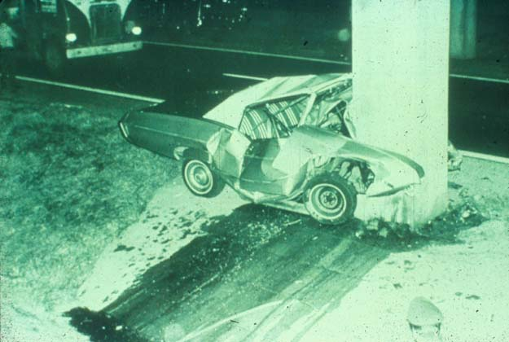

Slide 3
Distribution of global injury mortality by cause
全球伤害致死情况及死亡原因分布
Road traffic injuries account for 23% of all injury deaths worldwide
交通事故导致的创伤占全世界所有创伤死亡的23％
Source: WHO Global Burden of Disease, 2008

Slide 4
The facts
事实
3
Nearly 1.3 million deaths
死亡130万例
20-50 million injured伤害2-5千万例

Number of deaths (millions)
2
1.8


1.3
1.3
1

<1
Road traffic
WHO 2004
交通事故
AIDS-related deaths
UNAIDS 2008
艾滋病相关死亡
Tuberculosis
WHO 2008
肺结核
Malaria
WHO 2008
疟疾
Source: www.who.int/roadsafety, www.decadeofaction.org, 2011
Notes:
1.3 million deaths
20-50 million non-fatal injuries
Leading cause of death for people aged 15–29 years
Over 90% of road traffic deaths and injuries occur in LMI countries
1–3% of the gross national product
Only 15% of countries have comprehensive laws
Inadequate pre, acute & post crash care

Slide 5
2013 Road Traffic Deaths
China, United States and Wisconsin
2013年道路交通致死数据
中国，美国和威斯康星
Location 地区 | No. of Deaths All Ages 各年龄段死亡例数 | Population 人口 | Crude Rate per 100,000 population 每10万人口死亡粗率
China 中国 | 261,367 | 1,343,240,000 | 18.8
United States 美国 | 34,064 | 316,668,600 | 10.6
Wisconsin 威斯康星州 | 547 | 5,730,937 | 9.5
Source for Number of Deaths by Country & Crude Rate:
World Health Organization
http://apps.who.int/gho/data/node.main.A997
Source for Population by Country:
Index Mundi
http://www.indexmundi.com/g/g.aspx?v=21&c=hr&l=en
Source for Number of Deaths in Wisconsin and Wisconsin Population:
Wisconsin Interactive Statistics on Health
http://www.dhs.wisconsin.gov/wish/

Slide 6
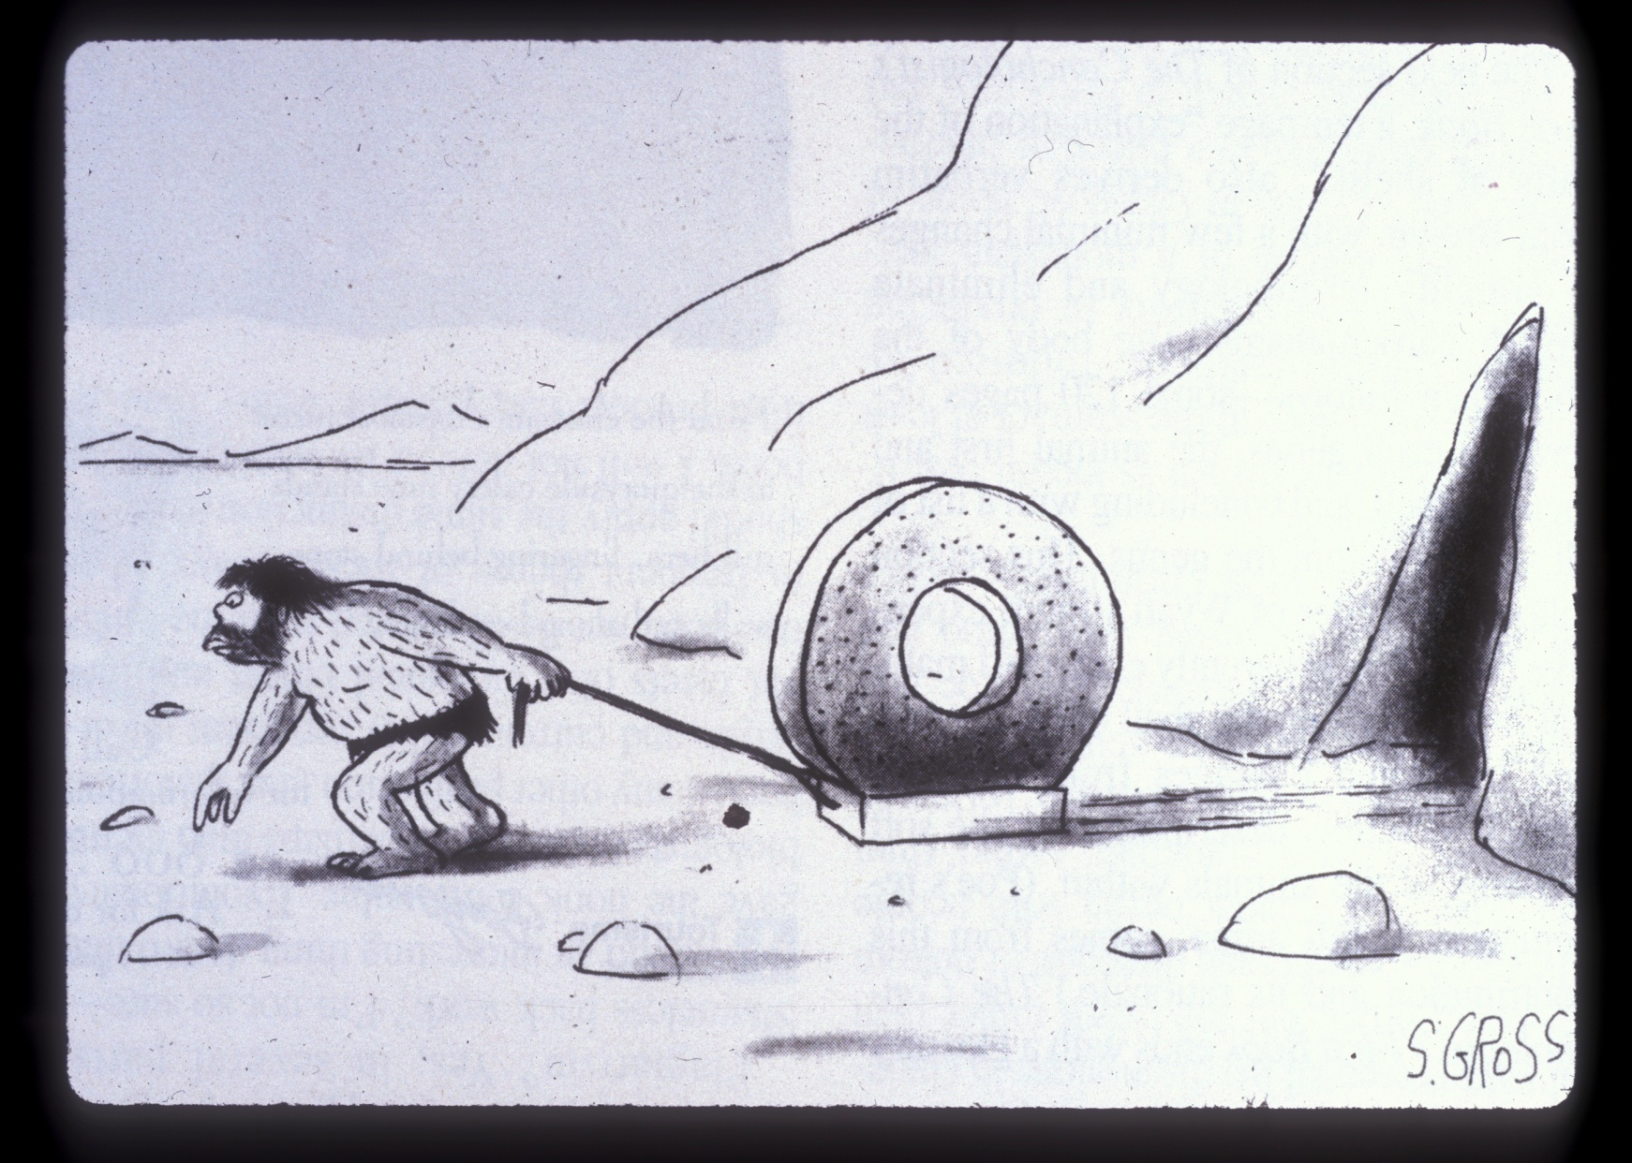

Slide 7
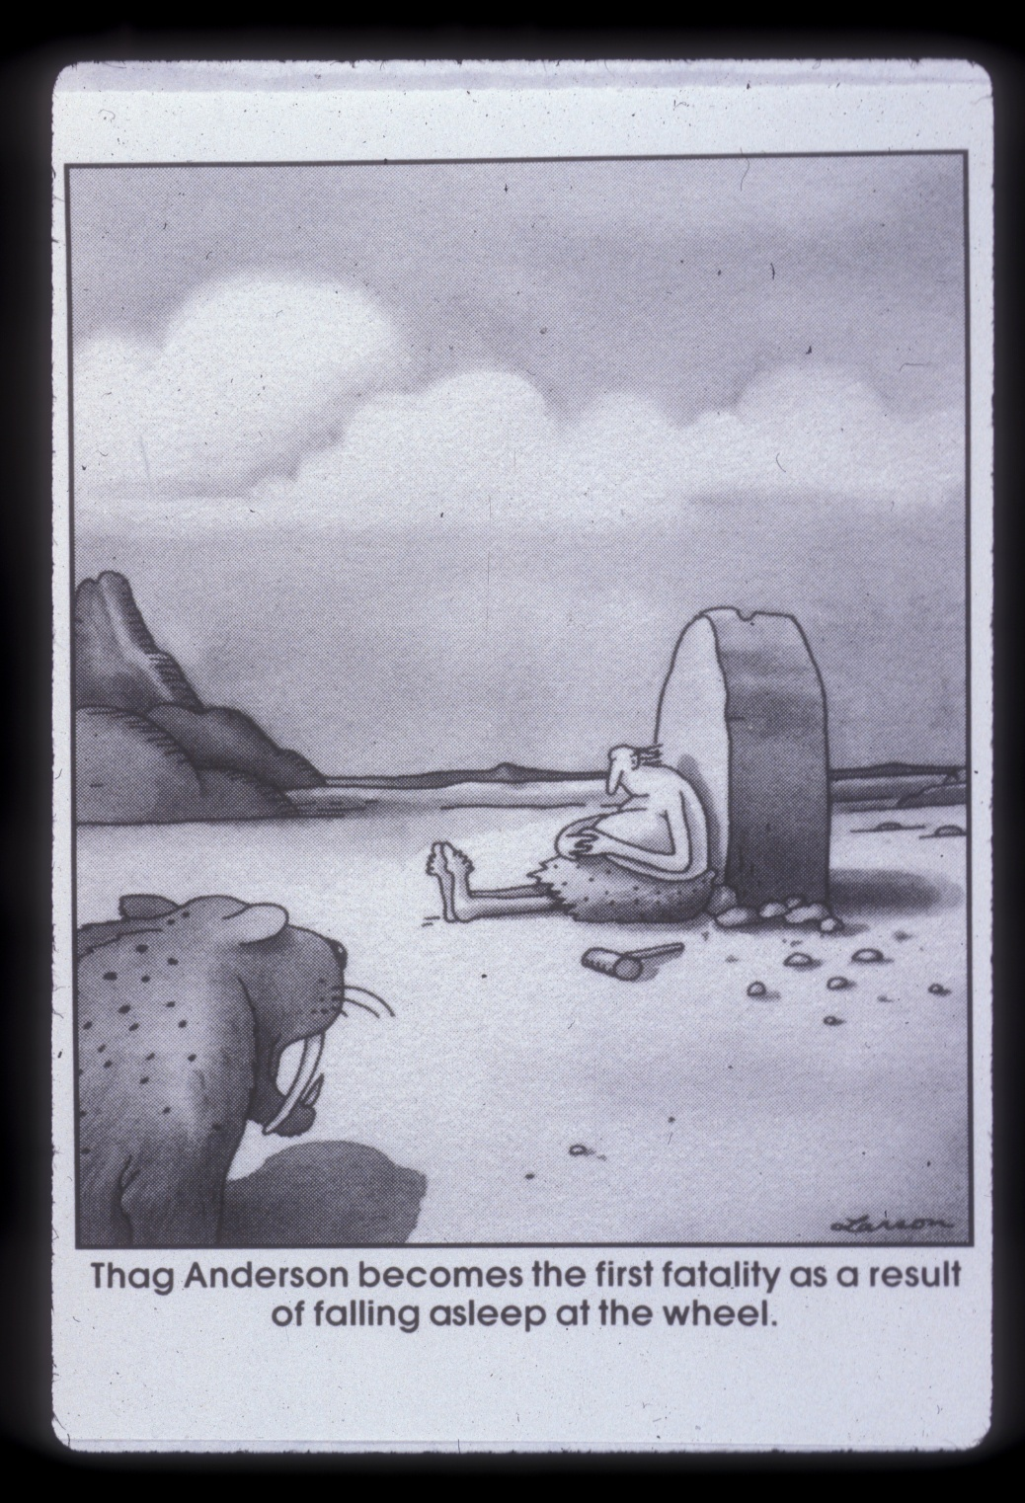

Slide 8
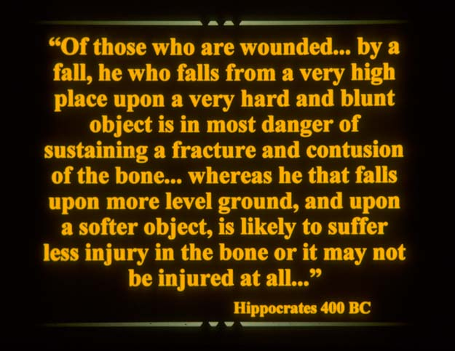

Slide 9
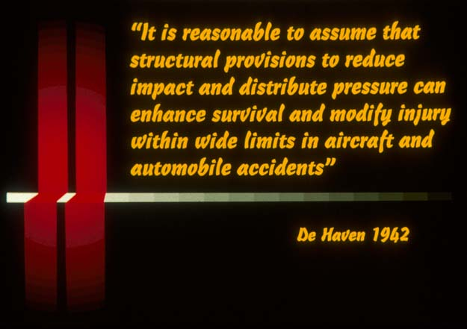

Slide 10
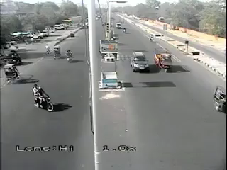

Slide 12
The Disease process
疾病的过程
The cause (etiology)病因
The mechanisms of its development (pathogenesis)发病机制
The structural alterations induces in cells/organs of the body (morphologic changes)结构的改变诱导体内细胞/器官的变化（形态学改变）
Functional consequences of the morphologic changes (clinical significance)形态变化导致的一系列后果（临床意义）
    Pathologic Basis of Disease, 7th Edition, page 4
    疾病的病理基础，第7版，第4页

Slide 13
Malaria
疟疾
Etiology: biologic agent: Vivax, Falcipirum
病因：生物因素：间日疟原虫，恶性疟原虫
Pathogenesis: Blood stream invasion
发病机制：通过血液入侵
Morphologic changes: lysis of cells
形态学变化：细胞裂解
Clinical significance: fever, cerebral edema, organ damage, death
临床意义：发烧，脑水肿，器官损伤，死亡

Slide 14
Injury: the Disease
伤害：疾病
Etiology: physicial agent: kinetic energy
病因：物理因素：动能
Pathogenesis: acute exposure to KE to cells/tissues unable to absorb---millisecond of exposure
发病机制：急性暴露于KE使细胞/组织无法吸收---毫秒的暴露
Morphologic changes: cell/tissue tearing/edema/bleeding/inflammation
形态变化：细胞/组织撕裂/水肿/出血/炎症
Clinical significance: fractures, hemorrhage, subdural hematomas, shock, death
临床意义：骨折，出血，硬膜下血肿，休克，死亡

Slide 15
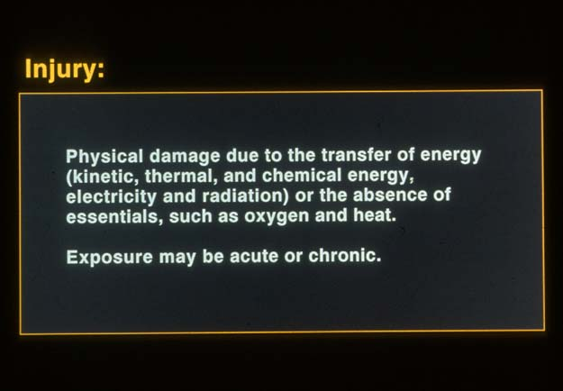
由于能量（动能，热能和化学能，电和辐射）的转移或者氧气和热等必需条件的缺乏而造成的物理损伤。
暴露可能是急性的或慢性的。

Slide 16
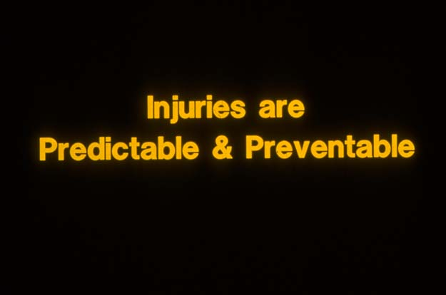
伤害是可预测及可预防的

Slide 17
Public Health Approach to Disease
公共卫生方法
Host宿主
Agent致病因子
Vector/Vehicle传播媒介
Environment环境

Slide 18
Public Health Approach to Disease
公共卫生方法
Malaria疟疾
  Agent: biologic: vivax
  致病因子：生物：疟原虫
  Vector: Mosquito
  传播媒介：蚊子
  Environment: Water
  环境：水源
  Host: children
  宿主：儿童
Motorcycle crashes
摩托车事故
  Agent: physical: kinetic energy
  致病因子：物理：动能
  Vector/Vehicle: Motorcycle
  传播媒介：摩托车
  Environment: Roads
  环境：道路
  Host: rider
  宿主：驾驶人

Slide 19
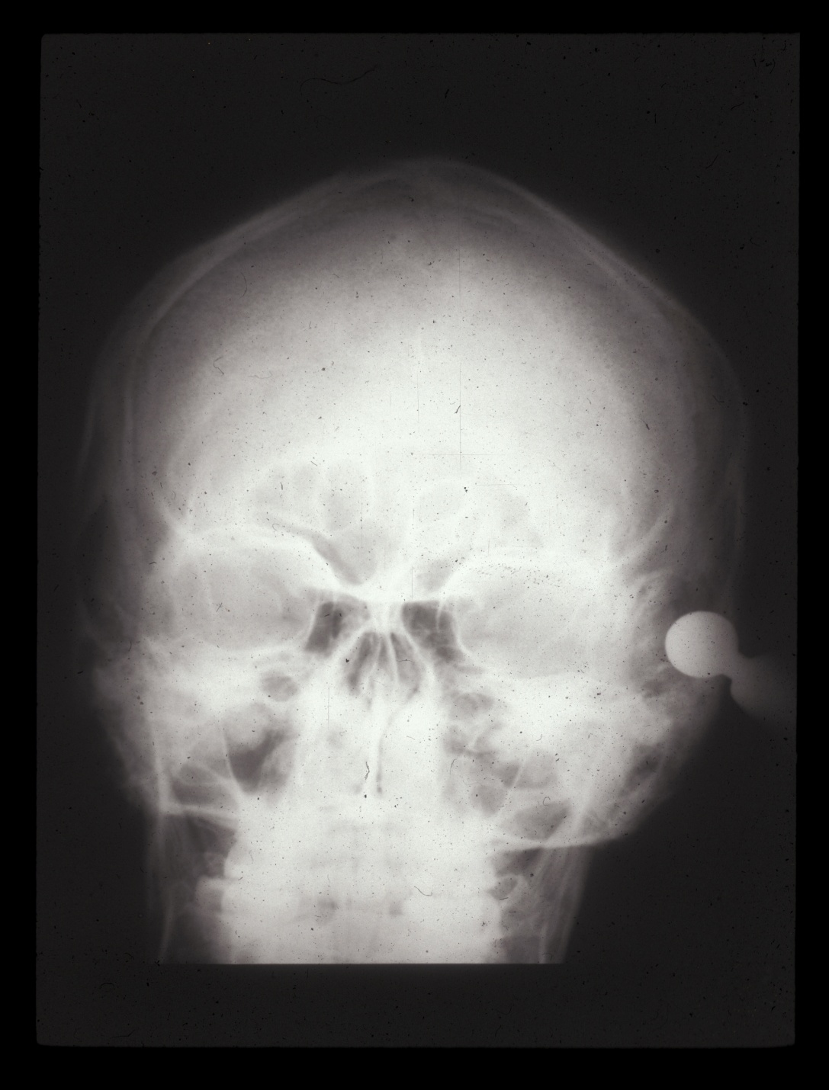

Slide 20
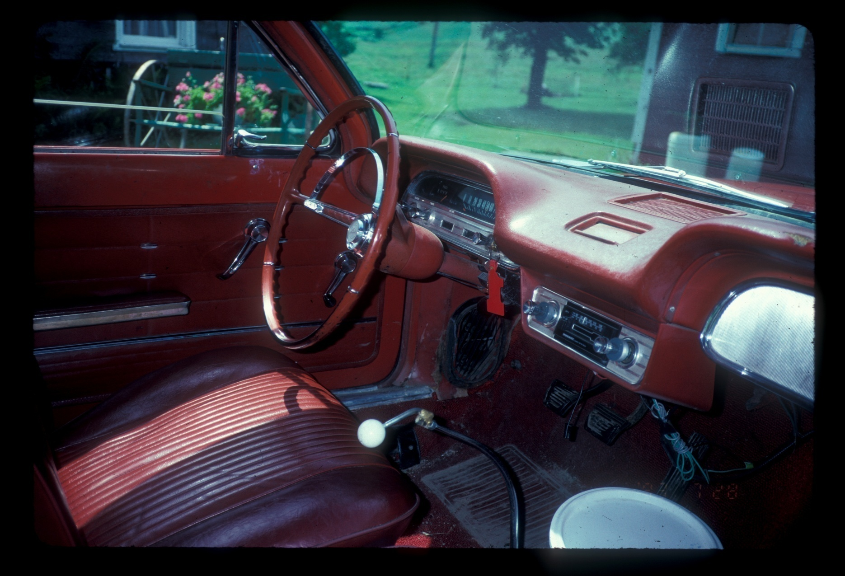

Slide 21
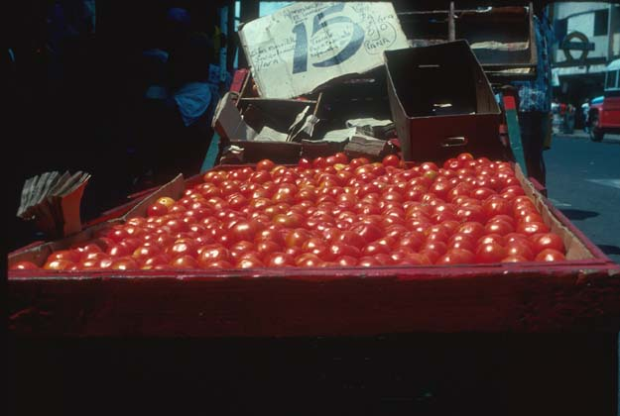

Slide 22
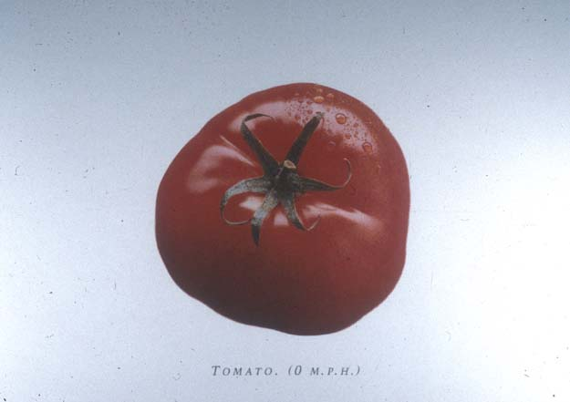

Slide 23
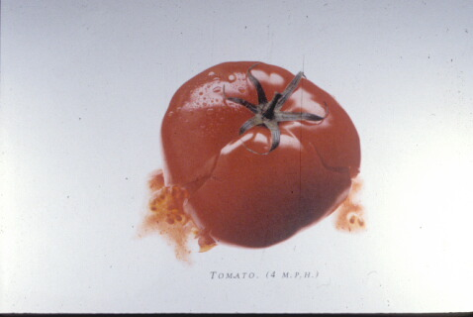

Slide 24
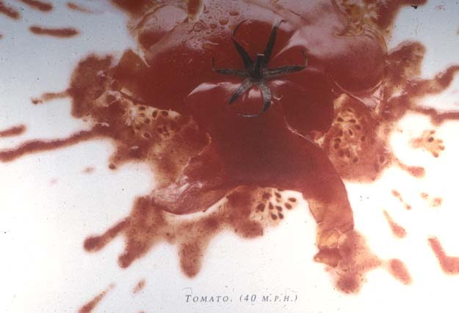

Slide 25
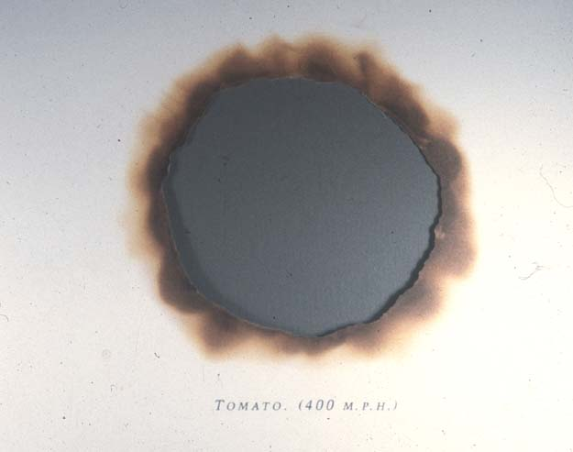

Slide 26
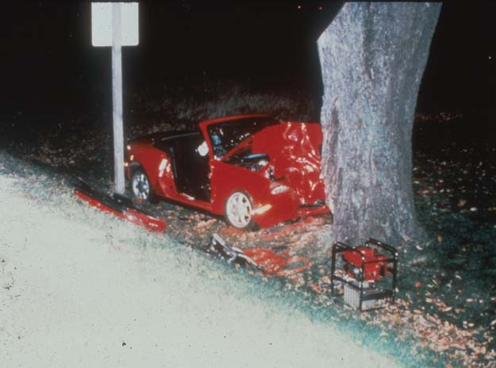

Slide 27
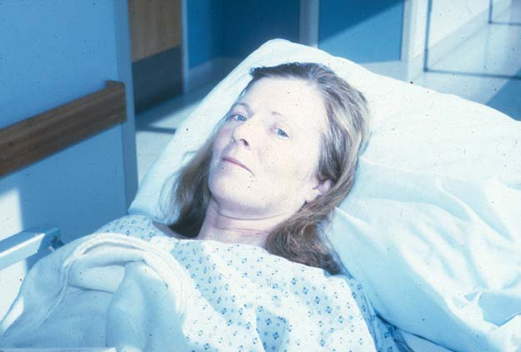

Slide 28
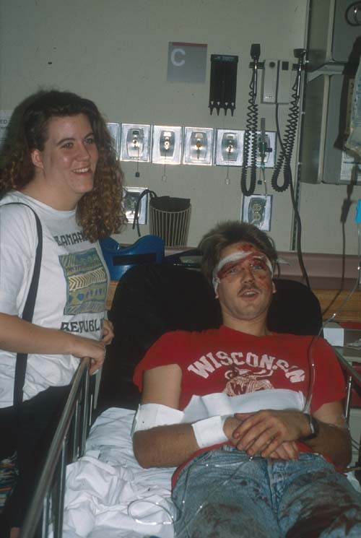

Slide 29
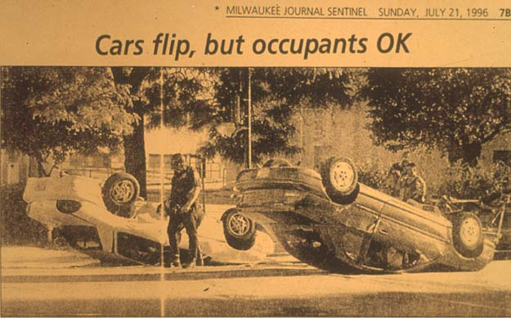

Slide 30
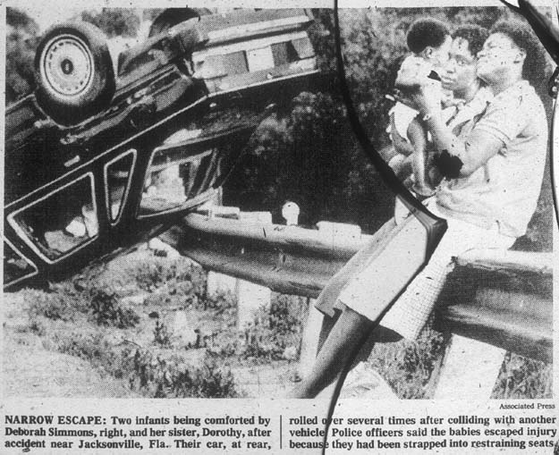

Slide 31


Slide 32
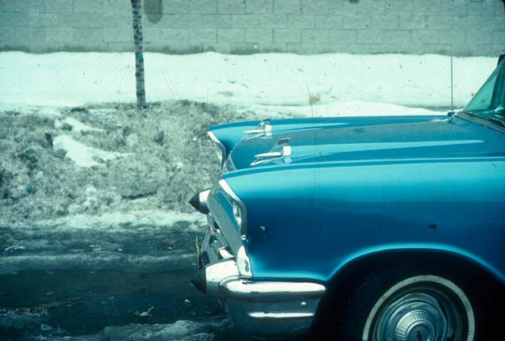

Slide 33
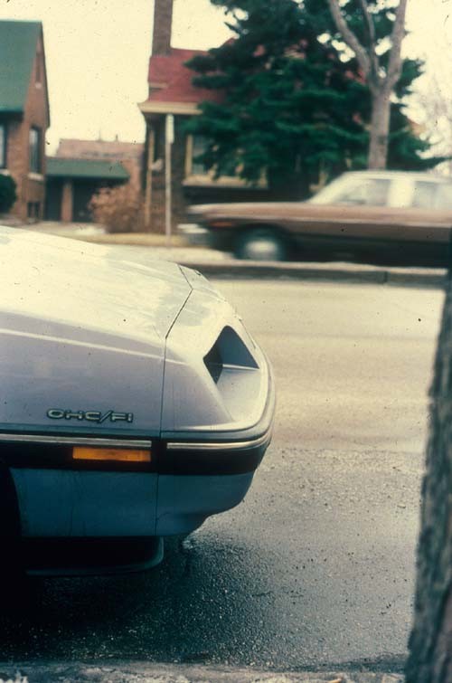

Slide 34
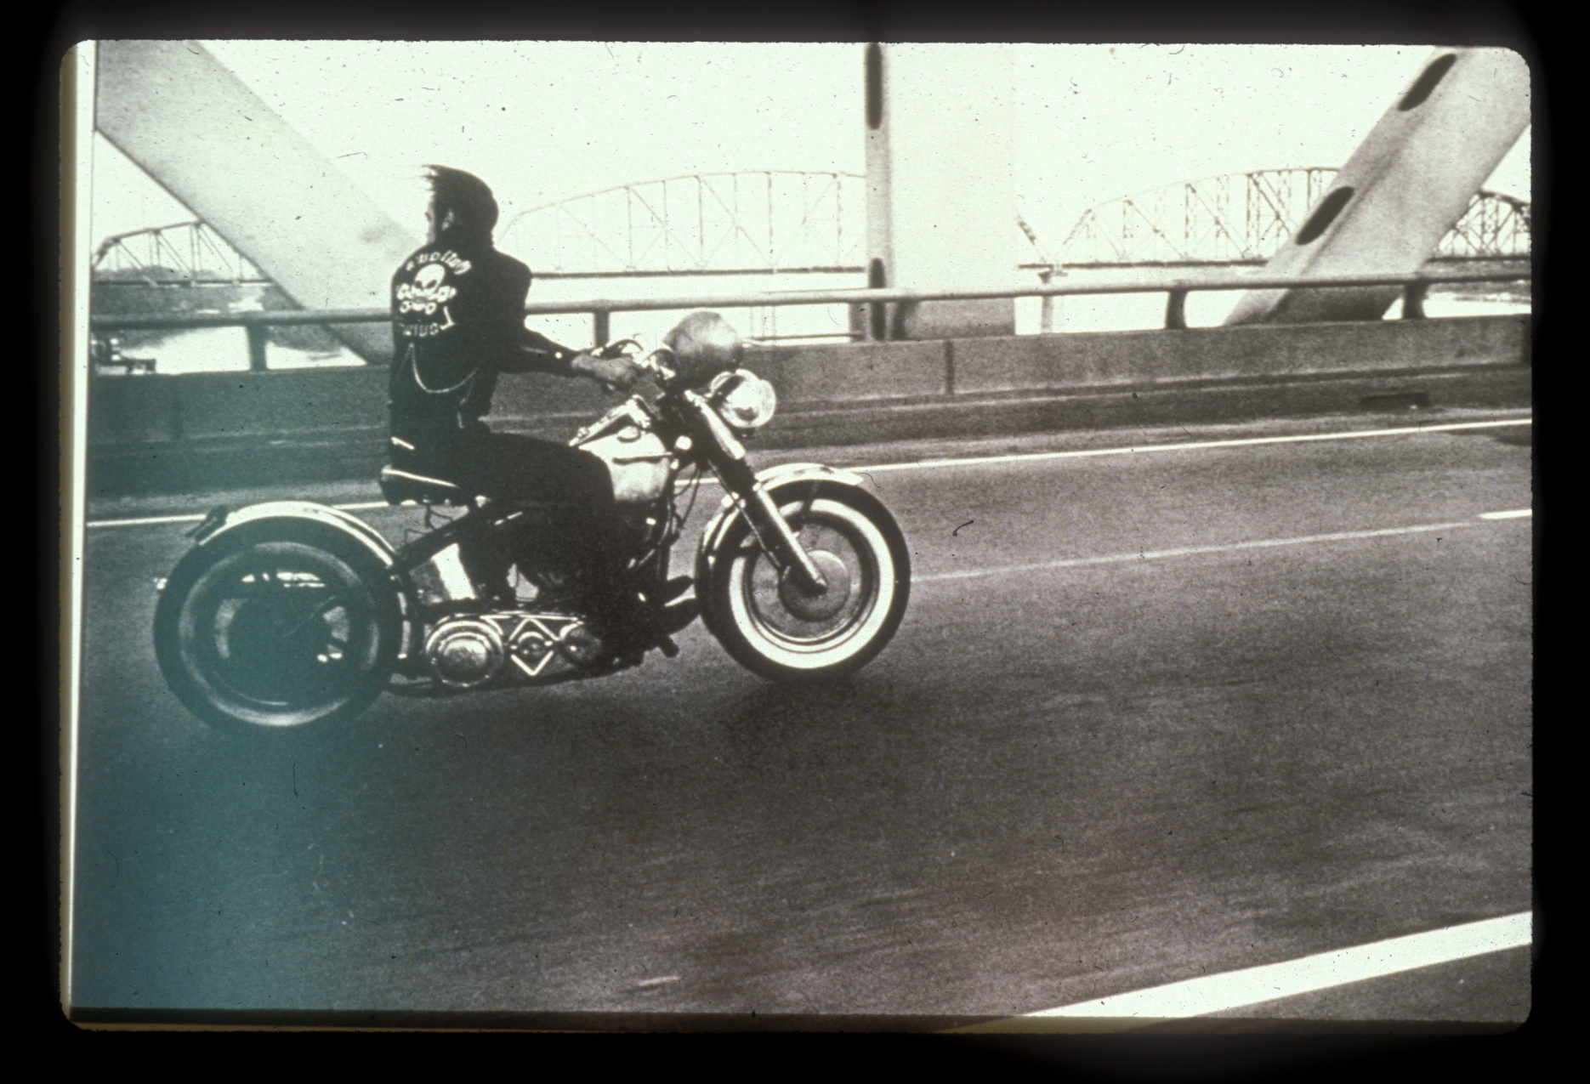

Slide 35
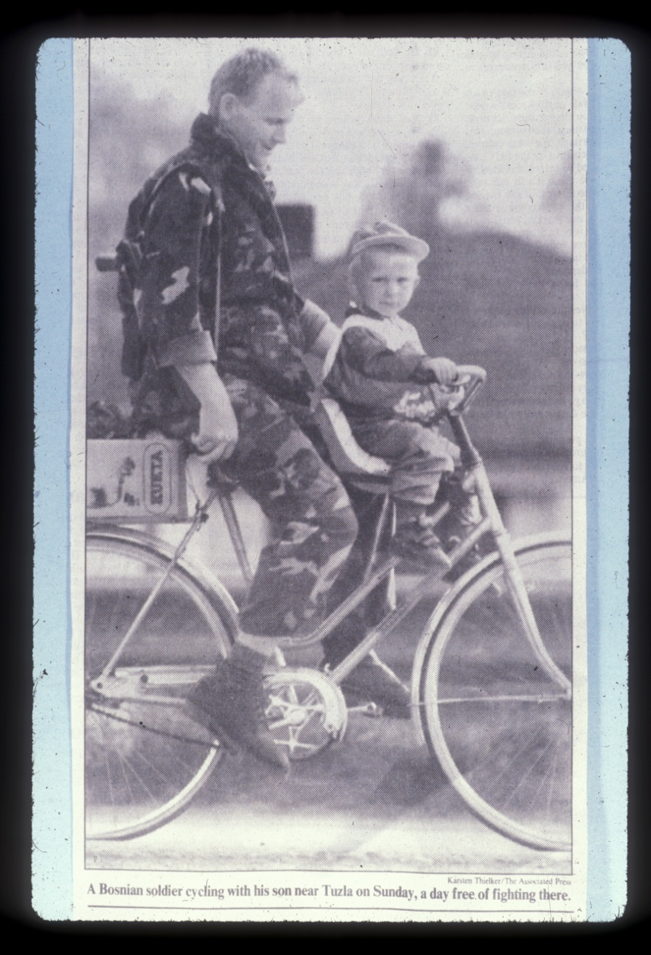

Slide 36
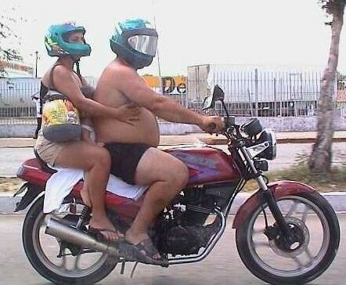

Slide 37
Key Points
要点
Worldwide, about 1.2 million persons are killed in road traffic crashes every year.
全世界每年有120万人死于交通事故。
20 million to 50 million more are injured or disabled in these crashes.
2-5千万人在事故中受伤或残疾。
Road traffic injuries account for 2.1% of global mortality and 23% of all injury deaths worldwide.
交通事故致死占全球死亡率的2.1％，占全球所有伤害死亡的23％。
Road traffic injuries are predicted to rise from tenth place to fifth place in 2030 as a cause of death.
道路交通的死因顺位预计将从目前的第十位上升为2030年的第五位。
Source: World Health Statistics 2008, World Health Organization

Slide 38
Growing situation
现状及其发展趋势
Top 10 leading causes of death
死因前十位
2004
2030
Rank | Disease or Injury
1 | Ischaemic heart disease缺血性心脏病
2 | Cerebrovascular disease脑血管疾病
3 | Lower respiratory infections下呼吸道感染
4 | Chronic obstructive pulmonary disease 慢性肺梗阻
5 | Diarrhoeal diseases腹泻
6 | HIV/AIDS艾滋病
7 | Tuberculosis肺结核
8 | Trachea, bronchus, lung cancer气管，支气管，肺癌
9 | Road traffic injuries交通致伤
10 | Prematurity & low-birth weight 早产
Rank | Disease or Injury
1 | Ischaemic heart disease
2 | Cerebrovascular disease
3 | Chronic obstructive pulmonary disease
4 | Lower respiratory infections
5 | Road traffic injuries
6 | Trachea, bronchus, lung cancer
7 | Diabetes mellitus
8 | Hypertensive heart disease
9 | Stomach cancer
10 | HIV/AIDS
Source: www.who.int/roadsafety, www.decadeofaction.org, 2011

Slide 39
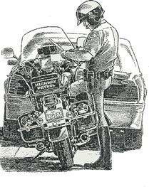
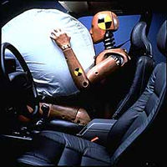
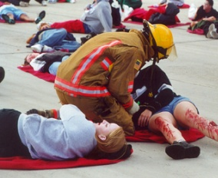
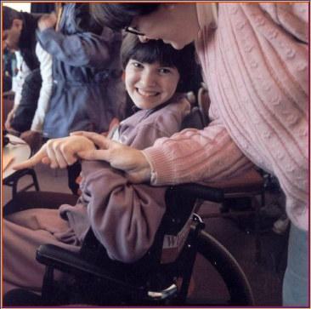

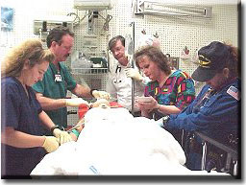
The Injury Field
创伤范围
Injury Prevention
伤害预防
Pre-event
Preventing injury
causing events
事故前
预防伤害事件发生
Event
Preventing injury
or minimizing severity
事故中
预防受伤或把伤害降至最低
Injury Treatment
伤害治疗
Acute Care
Minimizing severity
of outcome
应急护理
把伤害降到最低
Rehabilitation
Restoring optimum
恢复 到最佳状态

Slide 40
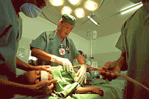
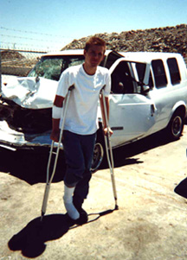
Major risk factors are identifiable主要风险因素是可识别的
Risk factors influencing post-crash outcome of injuries
影响伤害结果的危险因素
  delay in detecting crash延误事故诊断
  delay in transport to a health facility延误运送医疗机构
  fire resulting from collision碰撞事故造成的火灾
  leakage of hazardous materials有害物质泄漏
  alcohol and other drugs酒精等药物
  rescue, extraction, evacuation救援，脱身，疏散
  poor trauma care and rehabilitation恶劣的创伤护理和康复条件

Slide 41
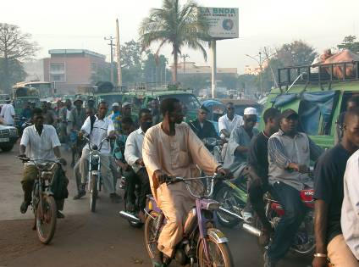
Patterns of injury vary in different parts of the world
世界不同地区的情况差异
High-income countries: drivers and passengers of car .
高收入国家：汽车的司机和乘客
Low- and middle-income countries: vulnerable road users (pedestrians, cyclists, people on public transport)低收入和中等收入国家：道路上的弱势群体（行人，骑自行车的人）
© D. Mohan, TRIPP
Notes:
41

Slide 42
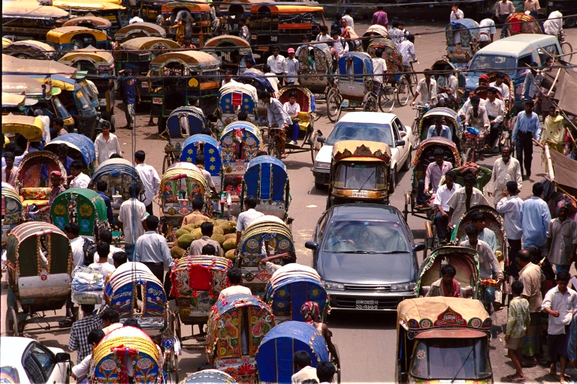
Multiple road users – Bangladesh
道路交通情况复杂 - 孟加拉国
Notes:
42

Slide 43
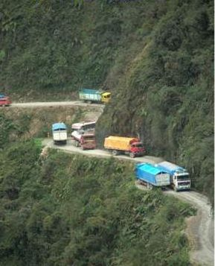
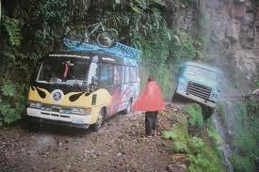
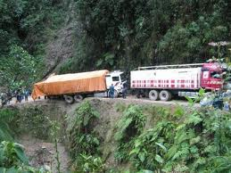
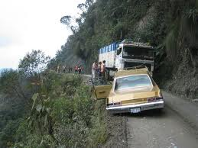

Slide 44
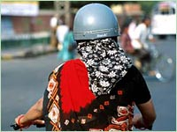

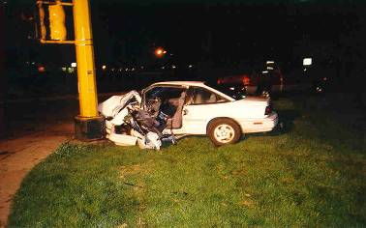
Major risk factors are identifiable
主要风险因素是可识别的
Risk factors influencing crash severity
影响撞击严重性的危险因素
  Speed速度
  seat-belts, child restraints 安全带，儿童安全带
  Helmets头盔
  Non-crash protective roadside objects
  无碰撞防护的路边物品
  insufficient vehicle crash protection
  车辆保护系统欠缺
  alcohol and other drugs酒精等药物

Slide 46
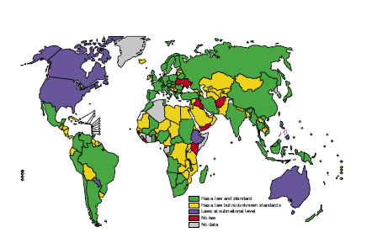
Motorcycle helmet laws and
regulations by country
实施摩托车头盔法律法规的国家
Law & standard
法律和标准
Law but unknown standards标准不明的法规
Subnational level law地方法律
No law无法律
No data无数据
Source: Global status report on road safety: time for action. Geneva, World Health Organization, 2009 (www.who.int/violence_injury_prevention/road_safety_status/2009).

Slide 47
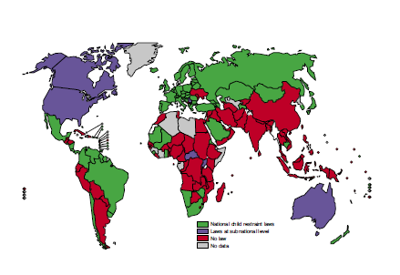
Child restraint laws by country
实施儿童安全座椅法律的国家
National law
国家法律
Subnational level law 地方法律
No law无法律
No data无数据
Source: Global status report on road safety: time for action. Geneva, World Health Organization, 2009 (www.who.int/violence_injury_prevention/road_safety_status/2009).

Slide 48
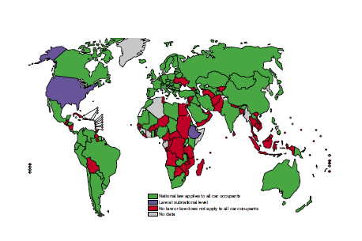
Seatbelt laws by country
实施安全带法律的国家
National law
国家法律
Subnational level law 地方法律
No law无法律
No data无数据
Source: Global status report on road safety: time for action. Geneva, World Health Organization, 2009 (www.who.int/violence_injury_prevention/road_safety_status/2009).

Slide 49
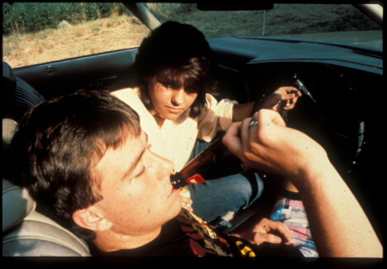

Slide 50
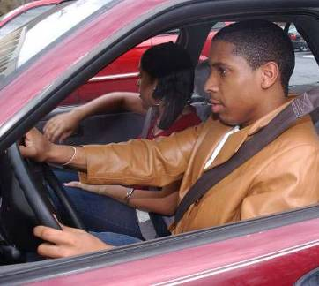


Best buys in road safety
道路安全的有效措施
  Speed reduction减速
  Seat-belts安全带
  Child-restraints儿童安全座椅
  Helmets头盔
  Drinking and driving禁止酒驾
  Low cost engineering measures
  低成本工程措施
  Safer vehicles安全的车辆
  Pre-hospital and Trauma care院前创伤护理
Laws
Enforcement
Standards
Behavior法律
强制执行
的标准
行为
Source: www.who.int/roadsafety, www.decadeofaction.org, 2011

Slide 51
Road safety is a shared responsibility
维护道路安全是大家共同的责任
GOVERNMENT & LEGISLATIVE BODIES
政府和立法机构
USERS / CITIZENS
使用者/公民
MEDIA媒体
ROAD TRAFFIC INJURY PREVENTIONPOLICY
道路交通伤害预防政策
INDUSTRY产业
PROFESSIONALS专业人士
NGOs, SPECIAL INTEREST GROUPS
非政府组织，兴趣小组
POLICE政策

Slide 52
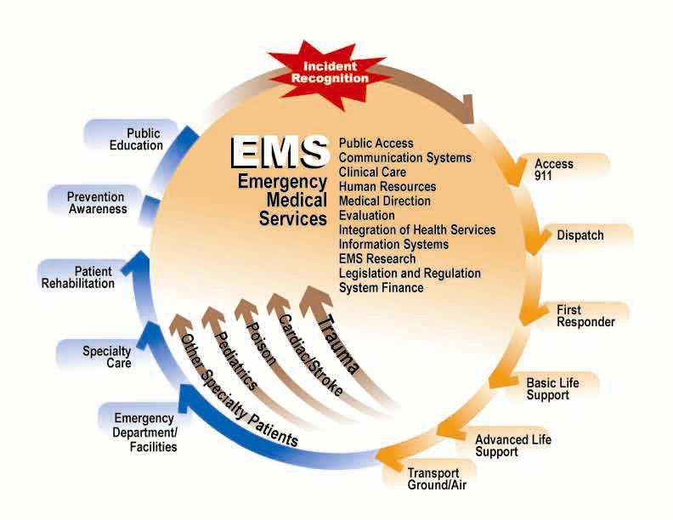

Slide 53
Public Health Approach
公共卫生的方法
2) Risk factor identification
What are the causes?
2）危险因素识别:原因是什么？
1) Surveillance
What is the problem?
1）监控:问题是什么？
4) Implementation
How is it done?
4）实施
如何做？
3) Develop and evaluate interventions
What works?
3）制定和评估干预措施
什么是有效的措施？

Slide 54
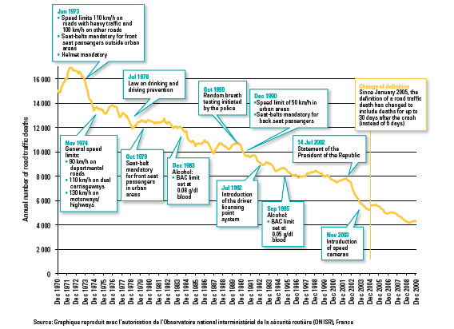
Best practices in prevention
最佳的预防方法
Evolution of the number of annual road traffic deaths in metropolitan France, 1970-2009
1970 - 2009年法国大都市每年道路交通死亡人数的演变

Slide 55
Downward Trends in Road Traffic Fatalities
in High-income Countries
高收入国家道路交通死亡呈现下降趋势

Slide 56
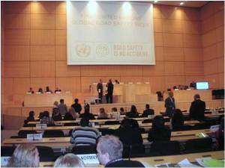
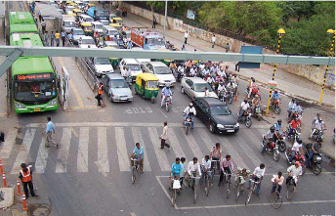

Pillars of the Plan
计划的核心内容
Road safety management
道路安全管理
Safer roads and mobility
道路的安全性和流动性
Safer vehicles
更安全的车辆
Safer road users
有安全意识的道路使用者
Post –crash response
碰撞后的应急处理
Source: www.who.int/roadsafety, www.decadeofaction.org, 2011

Slide 58

The world is run by those who show up
世界的前进是由一些人的出现而推动的

Slide 59
Thank you and Discussion
致谢和讨论
Stephen W Hargarten, MD, MPH
Associate Dean for Global Heath
Professor and Chair Emergency Medicine
hargart@mcw.edu
414-805-6454
www.mcw.edu/globalhealthprogram.htm

Slide 60
THE DECADE’S GOAL
十年目标（2011-2020年）
The overall goal of the Decade is to stabilize and then reduce the
forecast level of road traffic fatalities around the world by 2020
十年的总体目标是稳定，进而将死亡人数降至2020年的道路交通死亡人数预测水平
Source: www.who.int/roadsafety, www.decadeofaction.org, 2011

Slide 61


Slide 62
Road traffic deaths
交通事故致死
Proportion of Global Road Traffic Deaths by Type of Road User
全球道路交通死亡人数按道路用户类型划分的比例
6%
Others
46%
Pedestrian, cyclists and motorized two-wheels riders and passengers
46%行人，骑自行车的人和摩托车者
48%
Car occupants
48%汽车乘客
Source: www.who.int/roadsafety, www.decadeofaction.org, 2011

Slide 63

当我们最后离开学校开始工作时，我们是被教怎么赚钱而不是怎样发挥作用

Slide 64


Slide 65


Slide 66


Slide 67
Road traffic deaths
交通事故致死
Proportion of Global Road Traffic Deaths by Type of Road User
全球道路交通死亡人数按道路用户类型划分的比例
6%
Others
46%
Pedestrian, cyclists and motorized two-wheels riders and passengers
48%
Car occupants
Source: www.who.int/roadsafety, www.decadeofaction.org, 2011

Slide 68

The facts
事实
The leading cause of death
of young people aged
年轻人死亡的主要原因
15-29 years
Source: www.who.int/roadsafety, www.decadeofaction.org, 2011
Notes:
1.3 million deaths
20-50 million non-fatal injuries
Leading cause of death for people aged 15–29 years
Over 90% of road traffic deaths and injuries occur in LMI countries
1–3% of the gross national product
Only 15% of countries have comprehensive laws
Inadequate pre, acute & post crash care

Slide 69
90% of road traffic deaths and injuries occur in low-income and middle-income countries which have only 48% of the world's registered vehicles
90％的道路交通死亡和伤害发生在仅有世界注册车辆的48％的低收入和中等收入国家
Deaths vs vehicle ownership
死亡VS车主
Population
Road traffic deaths
Registered vehicles
Source: www.who.int/roadsafety, www.decadeofaction.org, 2011

Slide 70
Regional perspective
地区期望值
Road traffic injury fatality rates* per 100 000 population, by WHO region and income group
世卫组织区域和收入群体中每10万人口的道路交通伤害死亡率*
Source: www.who.int/roadsafety, www.decadeofaction.org, 2011

Slide 71
Everybody's Decade
每个人的十年
Private
Companies
私人公司
Victims and
Survivors
受害者和幸存者
Media媒体
A CULTURE
OF SAFETY
文化安全
Policy-Makers
政策制定者
Young
People
年轻群体
International
Organizations
国际组织
Nongovernmental
Organizations
非政府组织
Source: www.who.int/roadsafety, www.decadeofaction.org, 2011

Slide 72

huge public health and development problem
巨大的公共卫生和发展问题
1.2 million deaths a year
每年有120万人死亡
20-50 million are injured or disabled
有2千万到5千万人受伤或残疾
11th leading cause of death
死亡原因排第11位
account for 2.1% of all deaths globally
占全球所有死亡人数的2.1％
Copyright Etienne Creux, Pretoria News

Slide 73


Decade of action for road traffic safety 2011-2020
道路交通安全的十年期行动 2011-2020
November 2009
Called for by Moscow Ministerial Declaration
2009年11月莫斯科部长呼吁
March 2010
Tabled by Russian Federation, co-sponsored by 100 countries
& declared by the United National General Assembly
2010年3月由俄罗斯联邦制定，由100个国家共同赞助
并由联合国大会宣布
Source: www.who.int/roadsafety, www.decadeofaction.org, 2011

Slide 74






Decade of action for road traffic safety 2011-2020
道路交通安全的十年期行动 2011-2020
May 11, 2011
Statements of support from national & international leaders
国家和国际领导人的支持声明
>300 launch events, >80 countries
  Projection of the tag on national landmarks in New York, London, Rio de Janeiro, Geneva, Moscow, Warsaw, Colombo
  > 300个发射活动，> 80个国家在纽约，伦敦，里约热内卢，日内瓦，莫斯科，华沙，科伦坡的国家地标上标记的投影
Source: www.who.int/roadsafety, www.decadeofaction.org, 2011

Slide 75


Slide 76


Slide 77


Slide 78


Slide 79




MCW Global Health Program
威斯康辛医学院全球卫生计划
  GOAL
  Develop sustainable platform of local and global health to support education, research, clinical and public health training of our trainees and collaborative activities of faculty.
  目标
  建立地方和全球卫生的可持续平台，支持我们的学员的教育，研究，临床和公共卫生培训以及教师的协作活动
VISION
Train next generation of health leaders who address local and global health inequities across neighborhoods and nations
目光
培训下一代健康领导者，解决各个地区及国家的卫生条件不公平现象
MISSION
Reduce local and global health inequities through multi-national collaborative
partnerships in education, research, clinical and public health
任务
通过教育，研究，临床和公共卫生方面的多国合作，减少地方和全球卫生不公平现象
Source: Hargarten, et al. Three Year Global Health Program Strategic Plan, Medical College of Wisconsin, 2011

Slide 80
The world has complicated roadways
世界道路的复杂性
https://www.facebook.com/photo.php?v=1020366672106139
Notes:
An intersection in the capitol of Ethiopia

Slide 81


Slide 82

Five leading Causes of Death Children
儿童死亡的主要原因
Children under 5 years of age (2005)
五岁以下儿童
Transport crashes交通事故
Drowning溺水
Acute respiratory infections急性呼吸道感染
Septicemia败血症
Intestinal infectious diseases肠道感染

Slide 83


Slide 84


Slide 85


Slide 86


